Slide 1
Thank you
Notes:
First of all, thank you for the nomination and the award for the best intranet in Denmark 2016. We are really proud, happy and excited about the price but at the same time we also receive this price with a sense of awe.

Slide 2
Normann & Per
Notes:
My name is xxx and this is xxx. We both work for Realdania – a philanthropic organization that gives out grants to support the quality of lives for people in Denmark.

Slide 3
Realdania
Notes:
Our intranet is called “Jarmers Hjørne” – or in English “Jarmer’s Corner”. A name which came about after a naming competition in our organization.
We are actually very proud of our intranet which have created (and still creates) great value in our organization. With a strong strategic and conscious effort, it is an import tool to develop the culture of our organization
We also receive this price with awe because we know there are so many good intranet solutions out there – and many of you present many here today. Intranets that are also worthy of the title as Denmark’s best intranet 2016. We know of intranets, which in size, tools and cool features are better than ours.
But now that we have received the prize we would also like to defend it. And to understand the value of our intranet, we would to tell about ourselves and how our intranet has played a very important part in the transformation of our organization and the value that it has created for Realdania.

Slide 4
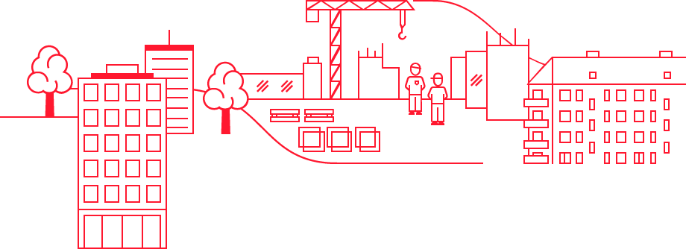
Our mission: We create quality of life through the built environment
Cities
Buildings
The built heritage

Slide 5
Projects
+2,800

Slide 6
Philanthropic donations
3.1 bn USD

Slide 7
Members
145,000

Slide 8
Employees
150

Slide 9
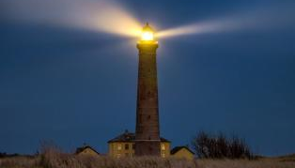
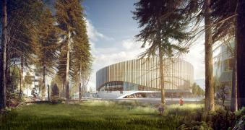
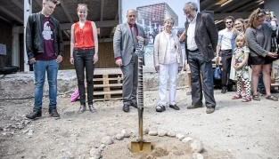
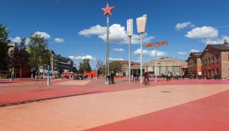
Skagen Grå Fyr
Royal Arena
Danmarks Rockmuseum
Superkilen
Dannerhuset
Den Blå Planet

Slide 10
Communication as a change agent
we take a problem-oriented approach to philanthropy.
involves a strong focus on:
communicating
network
dialog
advocacy
Notes:
Fra hvordan til hvorfor

Slide 11
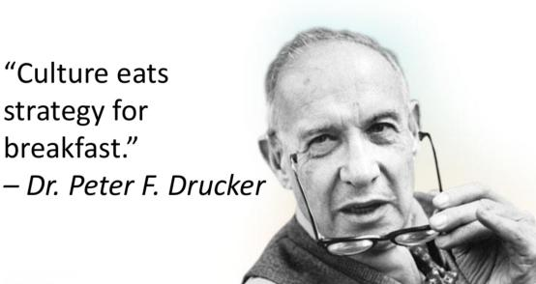
Business case
Old strategy
New strategy
Old Structure
New Structure
Old Culture
New Culture
Notes:
Old Strategy
More simple donation
Reactive communication
Old Structure
Silo organisation
House of brands
Old Culture
Old CIO
Top driven
Old scool
New Stratgy
Problem driven Philantropy
Proactive communication
New Structure
Cross organisation
One brand
New Culture
New CIO
All driven
Moden

Slide 12
Our intranet
Jarmers hjørne

Slide 13
Implemented
2015

Slide 14
Why a succes?

Slide 15
Few but clear goals

Slide 16
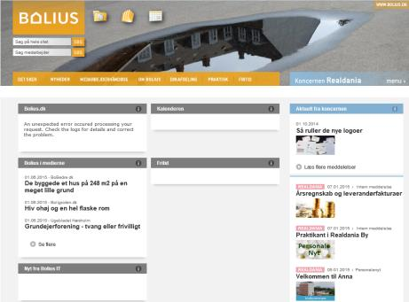
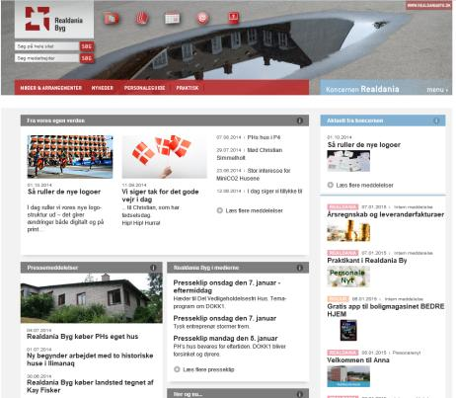
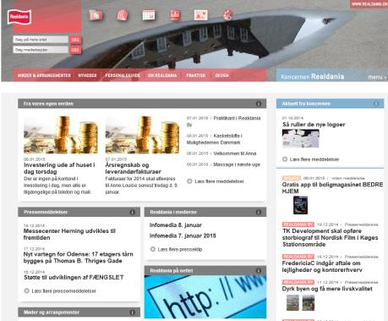
Before and after
From 4 ->1
One brand
Breaking down silos in the organization
Support communication, culture and collaboration
The experience that everyone works in one company
Increased accesibility

Slide 17
Culture: top-down

Slide 18
Culture: bottom-up

Slide 19
Out of the box intranet
Oxygen Software

Slide 20
Launch

Slide 21
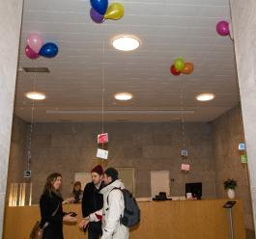
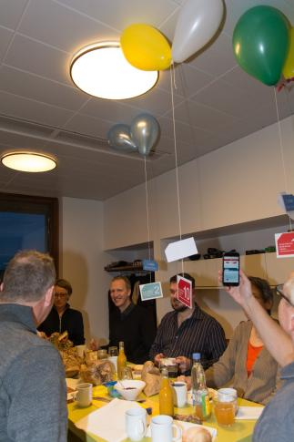
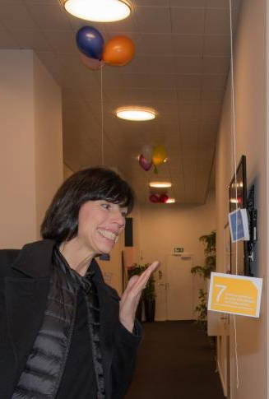
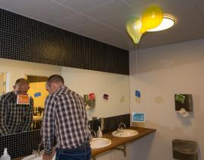
Launch

Slide 23
Launch
Naming competition
Ambassadors

Slide 24
Everyday use
Less control

Slide 25
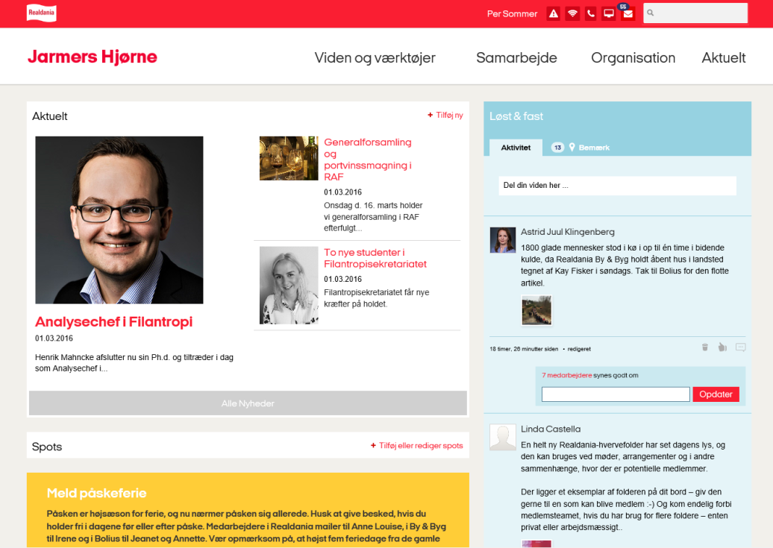

Slide 26
How did it go?
36.47 %
Useful

Slide 27
How did it go?
47.06 %
Very useful

Slide 28
How did it go?
16.47 %
Can’t live without it

Slide 29
How did it go?
0.00 %
Neutral

Slide 30
How did it go?
0.00 %
Not useful

Slide 31
Next step

Slide 32
Jarmers Hjørne
Communication
Culture
One brand
Engagement
Tools
From offline info to online
Workflows
Collaboration
Knowledge sharing
break down silos

Slide 33
Thank you
Notes:
Again Thanks a lot for the Intranet Award
We promise to hold the banner High

Slide 34
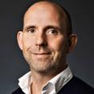
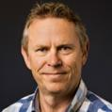
@PerSommerDK
Per Sommer
pso@realdania.dk
PerSommer
PerSommer
@norm_sloth
Normann Sloth
nsl@realdania.dk
NormannSloth
NormannSloth
Notes:
You are Allways welcome to Contact Per and me for dialog, information and comments
You Can Contact US on
Twitter, Instagram, LinkedIn, e-mail or simpelt just Rights after our præsentation
Thank you for listening and have good evening

